Slide 1
AWS Customer Churn Prediction System
CLOUD MACHINE LEARNING + BUSINESS ANALYTICS
Predicting at-risk subscribers on the Cell2Cell telecom dataset (~71,000 records) with serverless AWS services
Member 01 Ingestion · Member 02 Preprocessing and EDA · Member 03 Model training · Member 04 SQL analytics
Notes:
Introduce the project and the four-member structure that the rest of the deck follows.

Slide 2
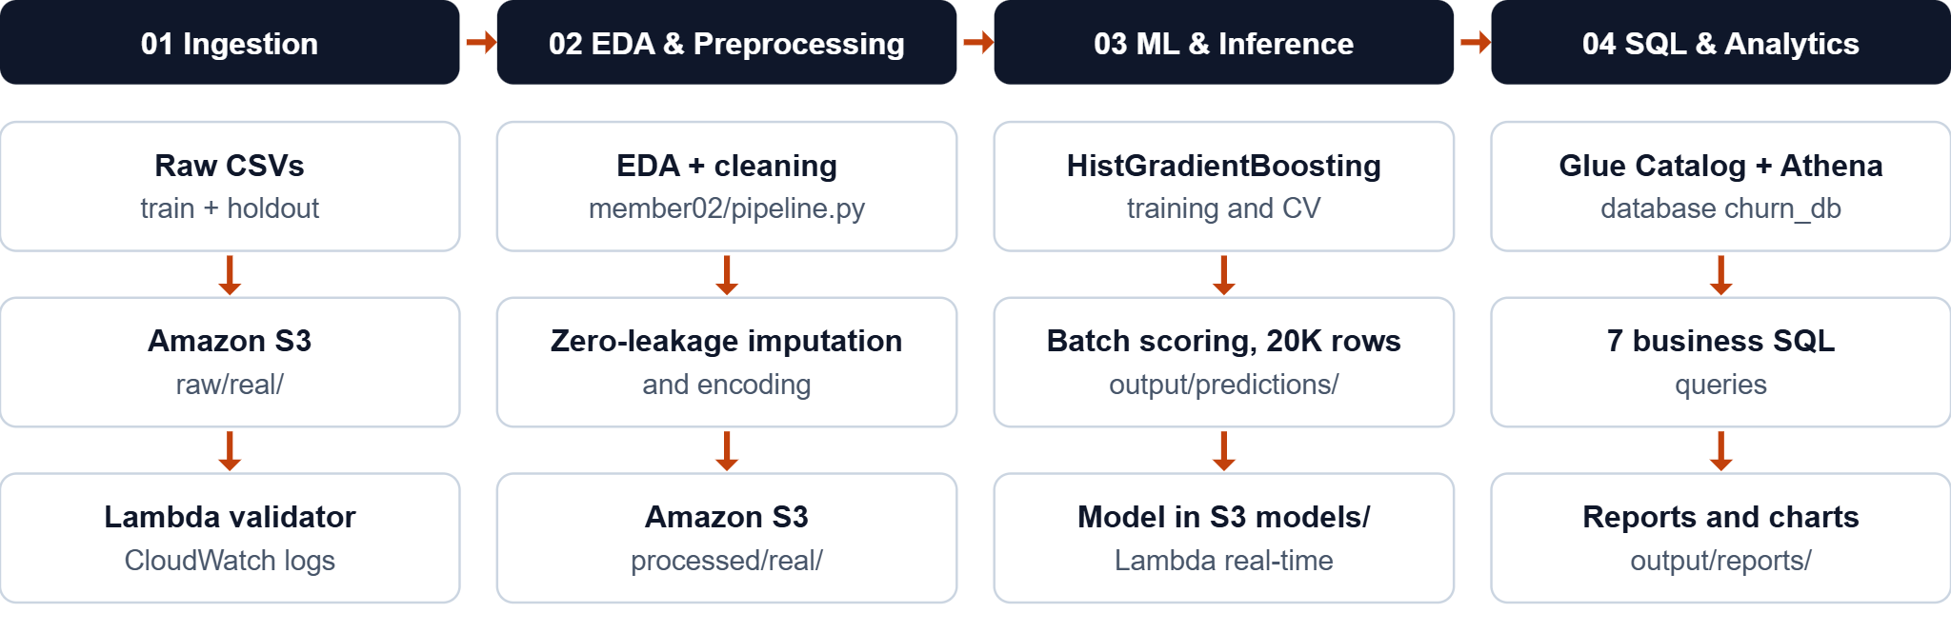
End-to-end serverless architecture
ARCHITECTURE
Bucket: churnpredictionaws-team-2026. Each member works under a least-privilege IAM policy.
AWS Customer Churn Prediction
2 / 10
Notes:
Walk the four stages left to right: ingestion, preprocessing and EDA, ML and inference, SQL analytics.

Slide 3
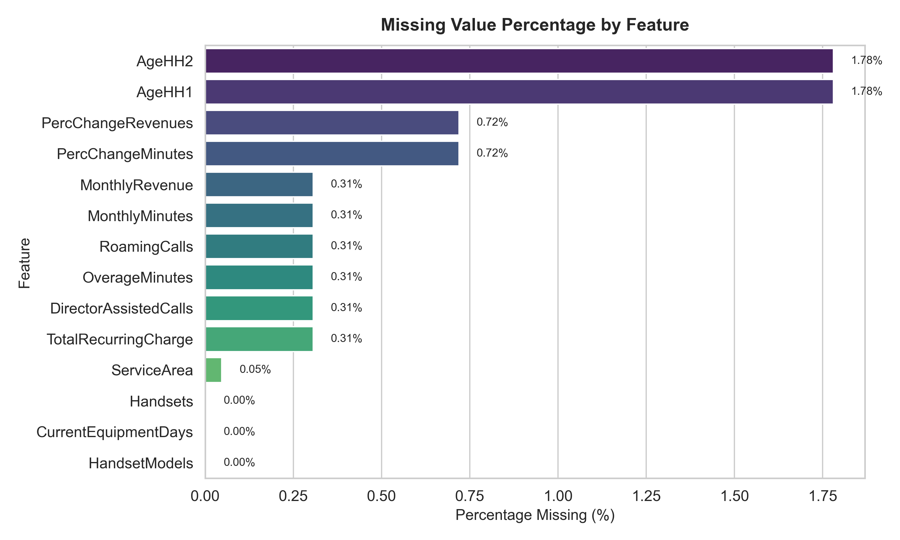
Cleaning the Cell2Cell data
MEMBER 02 · PREPROCESSING
51,047
20,000
training rows × 69 columns
holdout rows × 69 columns
14 features had missing values, at most 1.78% each
Median imputation fitted on train only, so nothing leaks into the holdout
ServiceArea gaps set to UNKNOWN; CustomerID kept for Athena
Missing values by feature in the raw training data.
AWS Customer Churn Prediction
3 / 10

Slide 4
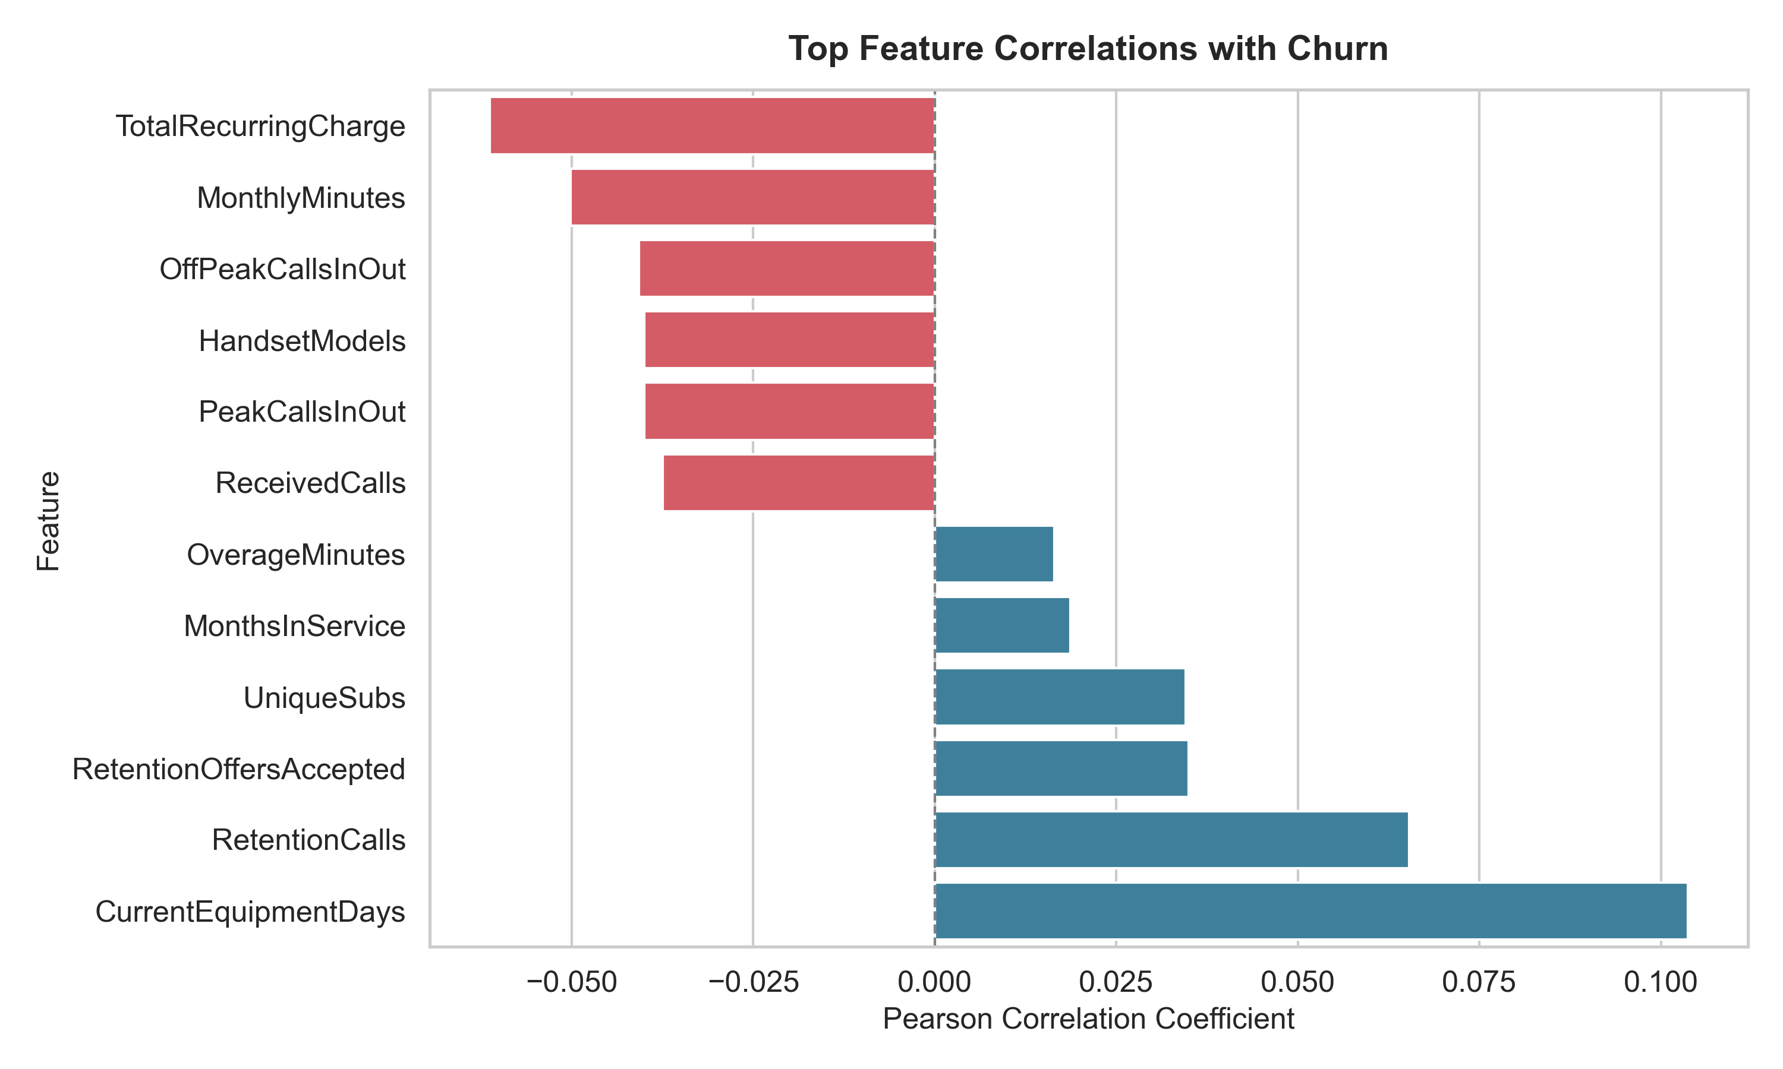
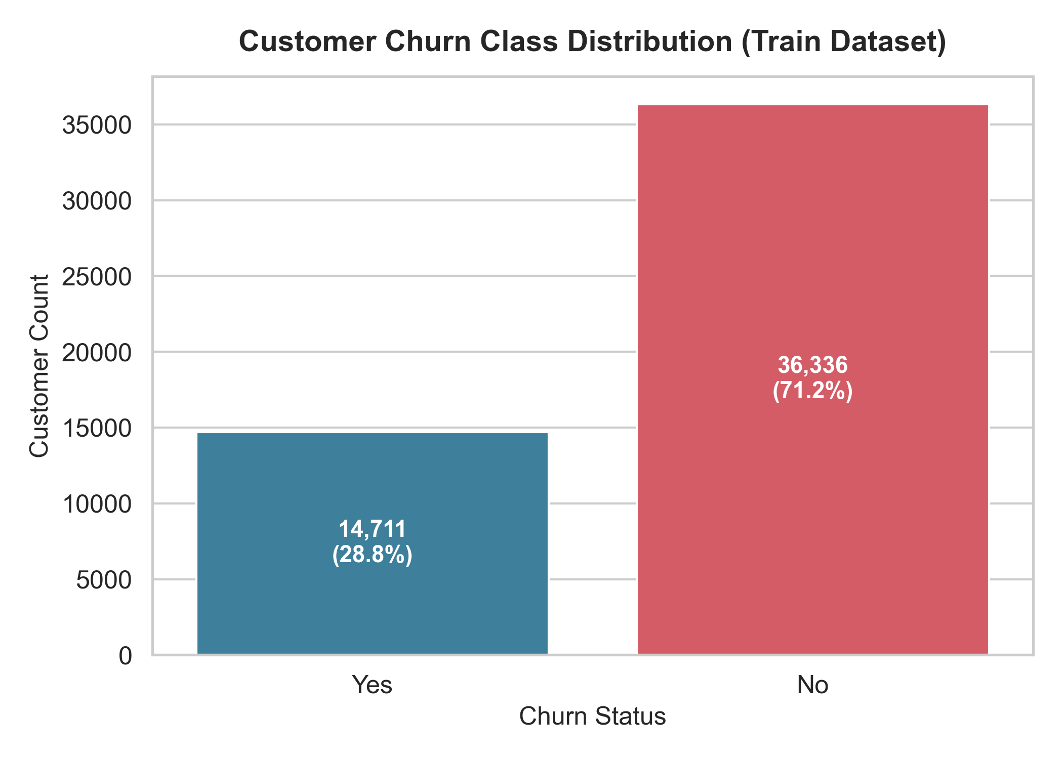
Target imbalance and churn correlations
MEMBER 02 · EDA
28.82% churned vs 71.18% retained, a 2.47 : 1 imbalance
Handset age (+0.10) and retention calls (+0.07) correlate most with churn; recurring charge (−0.06) and minutes (−0.05) with loyalty
Numeric features ranked by correlation with churn.
AWS Customer Churn Prediction
4 / 10

Slide 5
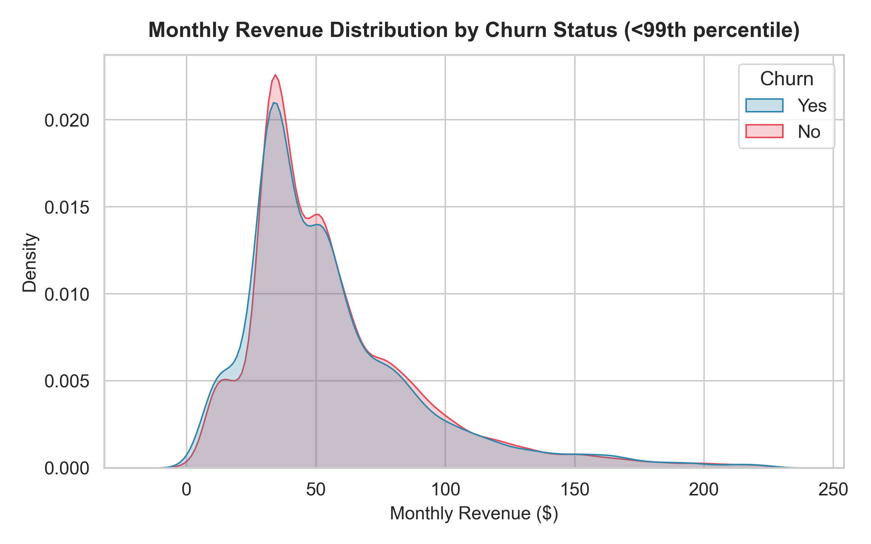
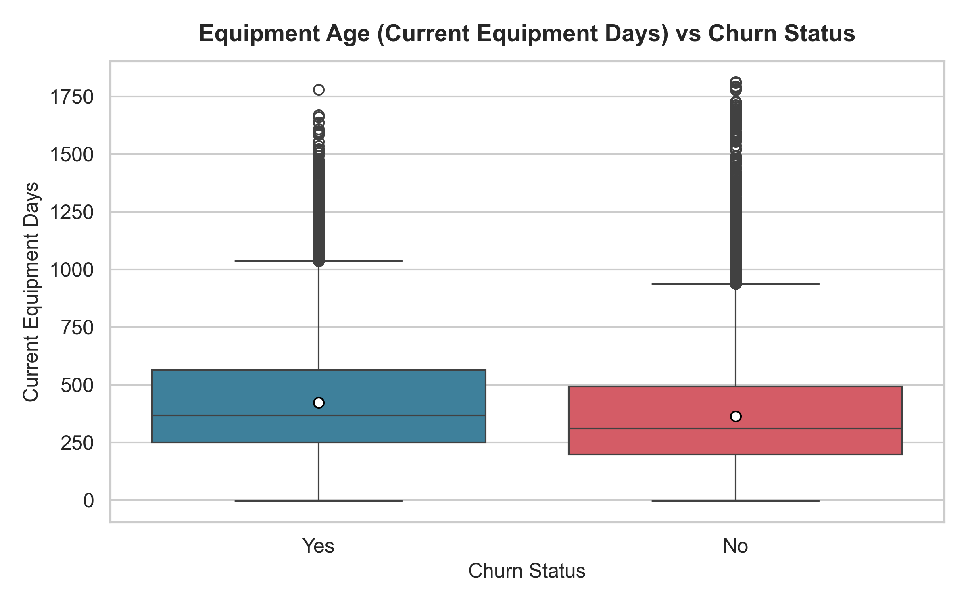
Revenue and handset age by churn status
MEMBER 02 · EDA
Revenue distributions of churned and retained customers almost overlap, so revenue alone barely separates them.
Churned customers hold older handsets, with a higher median age than retained customers.
AWS Customer Churn Prediction
5 / 10

Slide 6
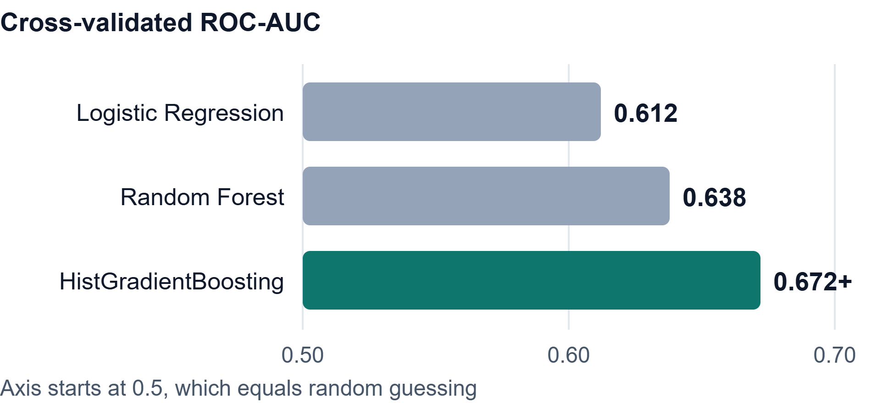
Training the champion model
MEMBER 03 · MODEL TRAINING
0.672+
Champion CV ROC-AUC (HistGradientBoosting)
Stratified 5-fold CV with balanced class weights
ColumnTransformer: median imputation, scaling, one-hot encoding
Saved as best_model_HistGradientBoosting.joblib in S3 models/
AWS Customer Churn Prediction
6 / 10

Slide 7
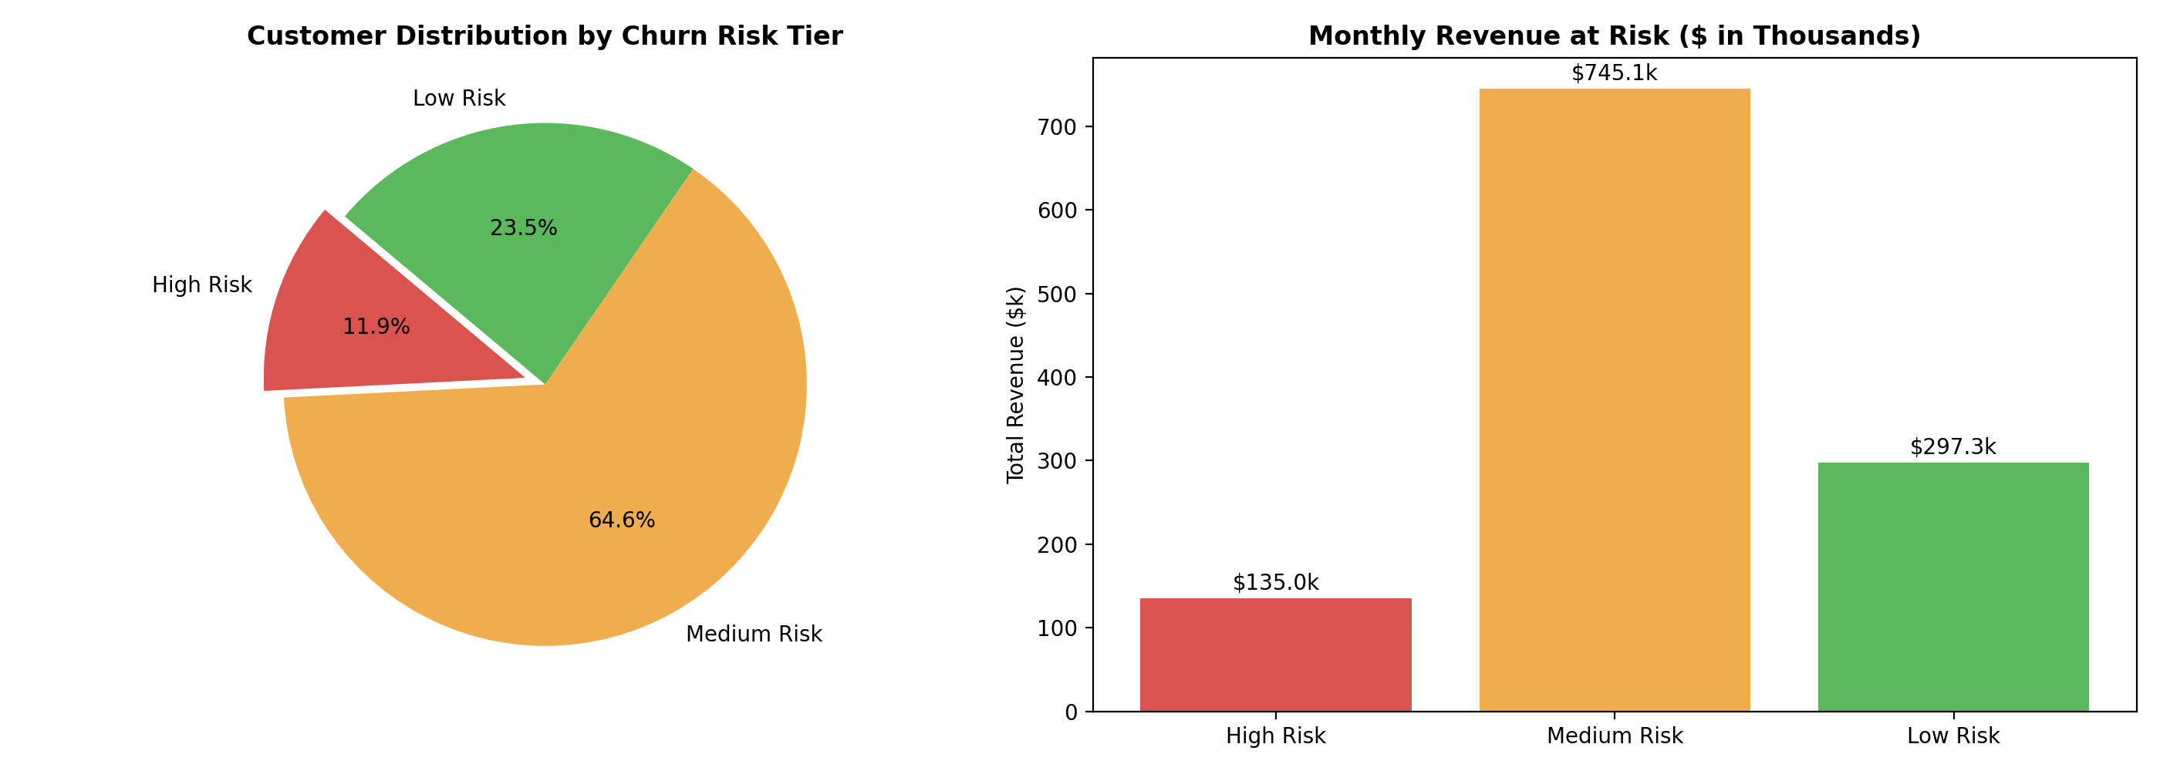
Scoring 20,000 holdout customers
MEMBER 03 · BATCH INFERENCE
11.91%
of customers fall in the high-risk tier
$139K
monthly revenue at risk in the high tier
$1.67M
High risk
Medium risk
Low risk
2,382 customers
above 65%
12,926 customers
35% to 65%
4,692 customers
below 35%
annualized exposure in the high tier
AWS Customer Churn Prediction
7 / 10

Slide 8
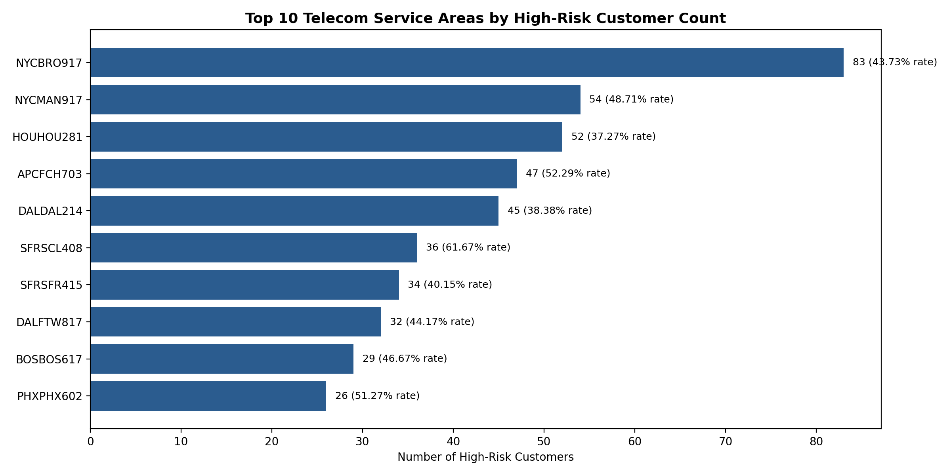
Athena SQL for churn analytics
MEMBER 04 · SQL QUERYING
Q1
Risk segmentation
Q2
Usage profile by tier
Q3
Service areas
Q4
Equipment age
Q5
Retention ROI
Q6
Credit rating
Q7
High-value targets
Query 3 ranks service areas by high-risk customers: NYCBRO917 (74), DALFTW817 (68) and LOSLAX213 (61).
Seven queries on churn_db.customer_predictions, run serverlessly in Athena.
AWS Customer Churn Prediction
8 / 10

Slide 9
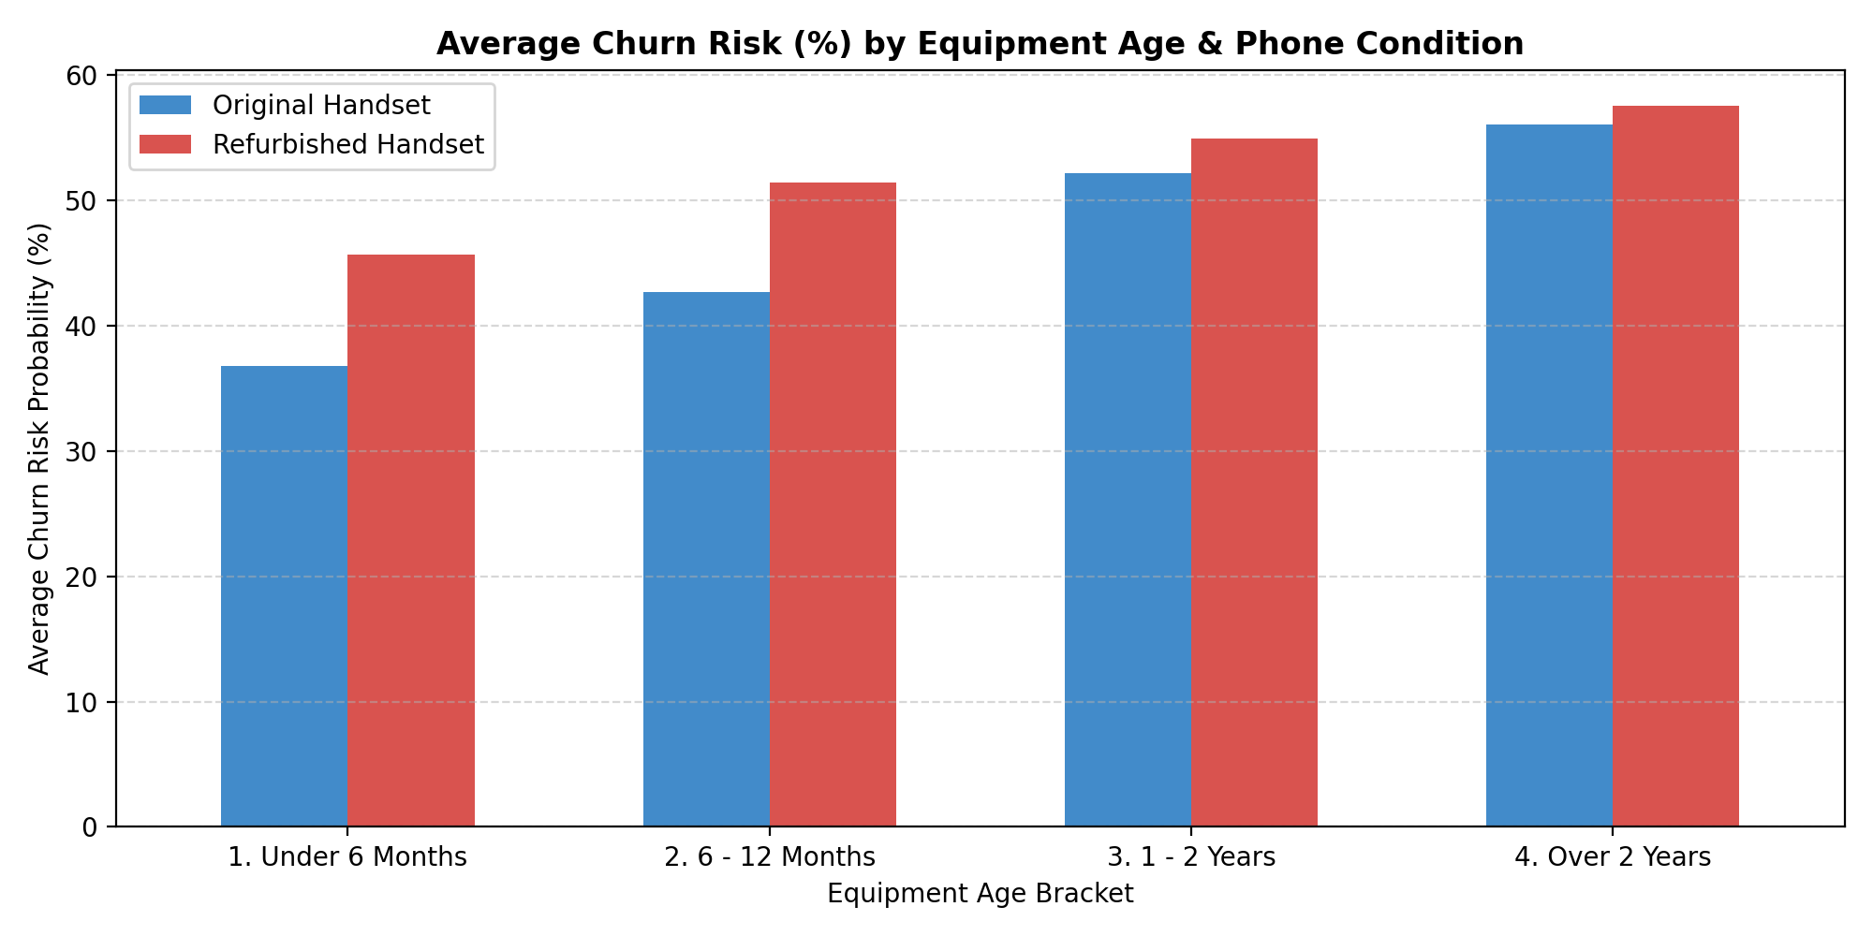
What drives churn
MEMBER 04 · BUSINESS INSIGHTS
38% → 51%
churn probability, handset under 6 months vs over 2 years
53.6% vs 44.1%
churn probability, customers who called retention vs not
49.2%
churn probability even after accepting a retention offer
Churn probability rises with handset age; refurbished-phone owners run 2.5 to 4.0 points higher at every age.
AWS Customer Churn Prediction
9 / 10

Slide 10
Recommendations
NEXT STEPS
2,382
1 year
Earlier
Prioritize high-risk customers worth $1.67M a year
Offer handset upgrades once devices pass about 1 year
Start retention outreach before customers call to cancel
Every stage runs locally or on AWS with python pipeline.py --mode cloud, under least-privilege IAM.
AWS Customer Churn Prediction
10 / 10

